Slide 1
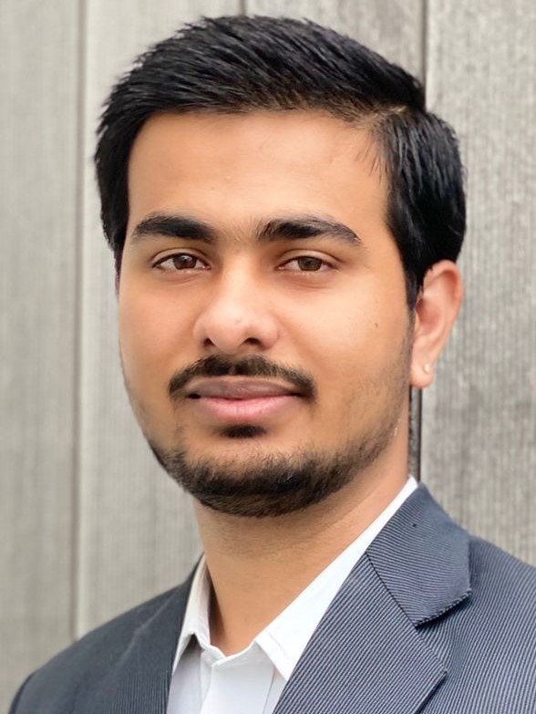
Tech Consulting New Joiner Postcard
Name: Abhishek Danalakota
My buddy: Alina Calistru(She is in parenting leaves now, so not sure who will be my next buddy)
My counsellor: Brian Bambrick
Sub Service Line: Microsoft
My key skills/background: 2.5 years of professional IT experience
My sector experience: IT Administrations, Cloud and API’s
Useful methodologies/tools I know: Azure, terraform, Agile scrum, ITIL v3.0 and Lean six sigma green belt
Any other work information
3 words to describe me… : Enthusiastic, motivated and hard working
In my free time I enjoy… : Watching movies and stay on bed all the time.
One interesting fact about me… : I will cook very good
Top of my bucket list… : Want to work in USA
Top tip for working with me… : Easy going and team work
Insert a second, more casual Picture here – Please use high resolution and use up all of the space available in this box
“
Favourite Quote
“In the end, it’s not the years in your life that count. It’s the life in your years.” – Abraham Lincoln

